Slide 1
Mycar Dream Assignment SUBMISSION
Sai sasank cheela
DDA1610187

Slide 2
Model to automate the process of predicting the car mileage
We build a predictive model using Linear regression technique for My Dream car company , The business model of the company is solely based on consumer interest, aiming to provide the most appropriate car to their clients and hence maximise the customer satisfaction , Nowadays, the automobile market has become very dynamic as the buyers have varied preferences, Customers look for various features (brand value, mileage, model year etc) in their dream car. In order to fulfil it's customer requirement here we automate the process of predicting the car mileage which fits the customer preferences using the past data that has been collected from various sources. We also identify the top factors that contribute to MPG of the car and provide best suggestion by predicting the MPG of a car based on its parameters.

Slide 3
Model Deployment methodology
Business Understanding
Data standardization
Model Evaluation
Is the Model predicting
Accurately ?
YES
Data Understanding
Feature engineering
Use model for prediction.
Data Cleaning
Model Deployment
NO

Slide 4
Model Results
The resulting Model suggests us the combination of non-correlated , independent variables/car parameters which impact the MPG the most among the variables which are provided in the data set.
Upon creating the model we find below parameters to be more significant.
Weight
Model Year
Number of Cylinders
The model is highly predictive in nature as it shows 83% (R squared) of accuracy.
The model gives high accuracy (test R-squared = 83% ) when tested it on the test dataset.
There is a Correlation of 91 % between the actual and predicted values.
The Model would Predict MPG for a car with required attributes ( Weight of car, Number of cylinders in it , model Year) with accurate results 83% times for new data.

Slide 5
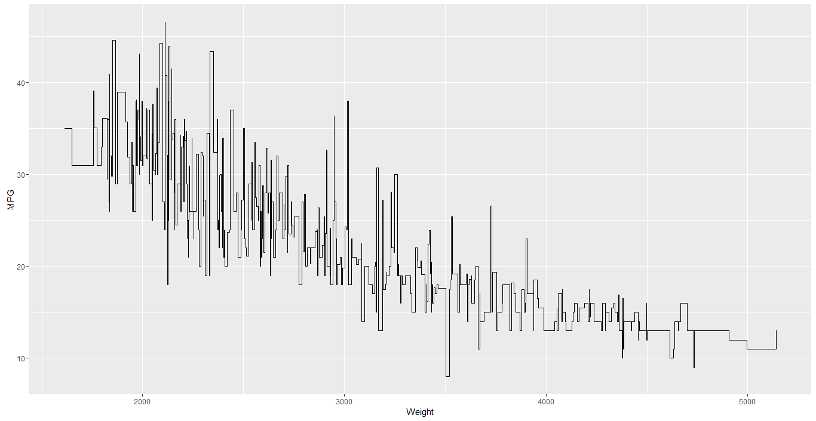
Impact of weight on MPG
Weight is a major factor that contributes to the MPG.
Higher the Weight lesser the MPG.
It is evident that light weight cars give more MPG so customers should be suggested light weight cars for more MPG.
There are also cases in which for nearly same weight of the car there are other values of Higher/Lower MGP Values, so we consider other factors suggested by model.

Slide 6
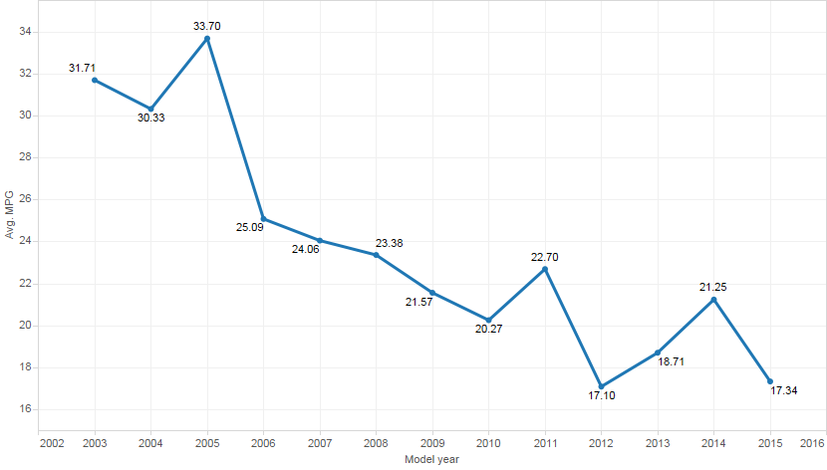
Model Year Impact on MPG
Model suggests that there is impact of model year on the MPG of the car.
Model year parameter suggests that if the model of the car is after 2007 then the MPG would be Lesser as there is a negative correlation between MPG and Model Year.
Cars whose model year is below 2007 would provide far better MPG compared to other model years as per data set.
It is also evident that the MPG is not reducing for all the Model Years but we could see that at times there is a significant rise in Average MPG of cars for some years hence we also need to consider other factors suggested by the model.

Slide 7
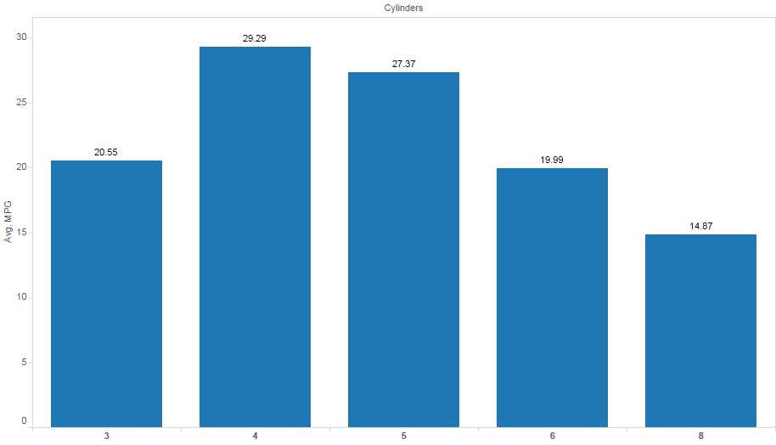
Cylinders Impact on MPG
Higher the Number of cylinders , lesser the MPG.
Model suggests that when the number of cylinders is 4 or 5 the Average MPG of the car will be high compared to other number of cylinders as per the data set.

Slide 8
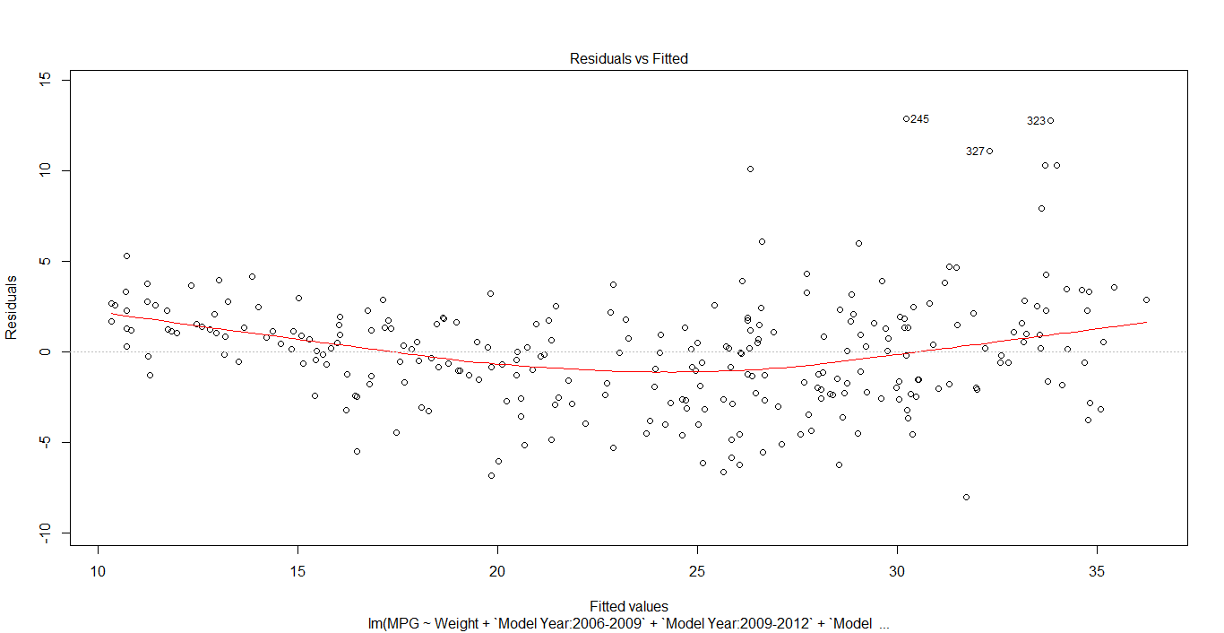
Residual Plot
X axis contains predicted Y values as per model and Y axis contains Residuals/Errors.

Slide 9
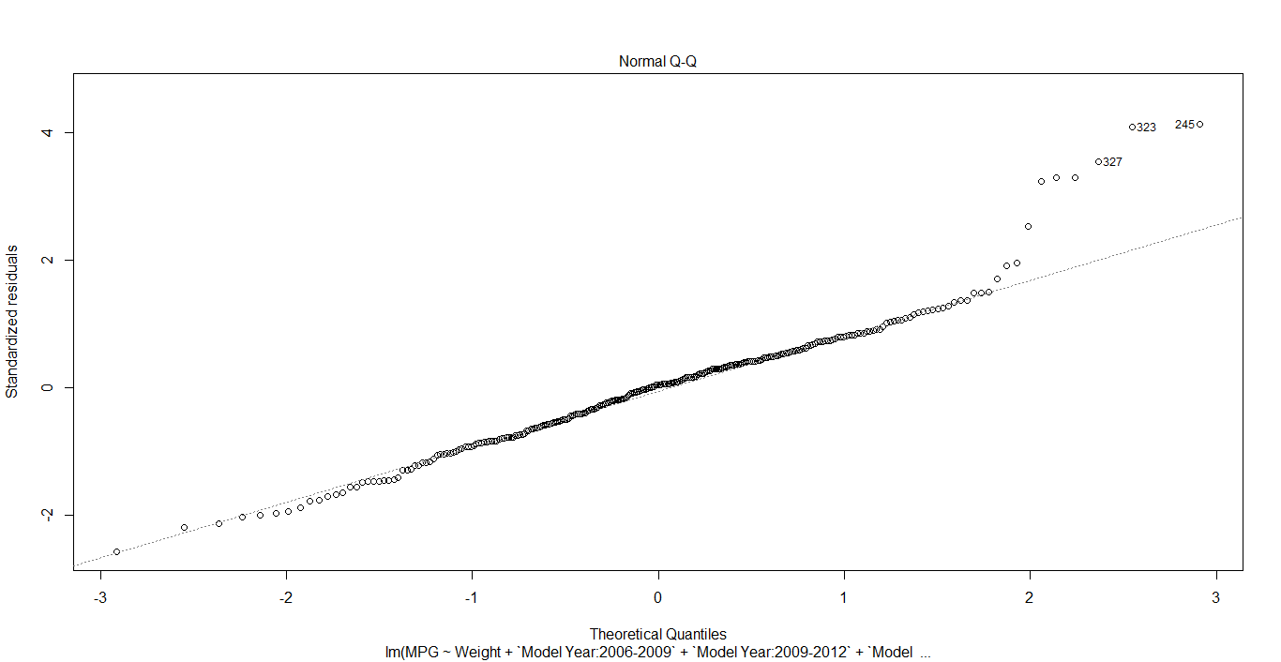
QQ Plot
Y Axis is ordered/Observed standardized residuals and X axis is ordered theoretical residuals

Slide 10
Conclusion about the Model
We have made a predictive model which predicts the MPG of a car based on the parameters given.
The following parameters are used to estimate the MPG as per the constructed model
1.Weight of car
2. Model Year of the car
3.Number of cylinders
Model does its prediction based on the above parameters as they are independent variables.
The model gives an accuracy of 83% when tested using a test data set.
There is a Correlation of 91 % between the actual and predicted values.
So the Model is acceptable for future analysis to predict MPG values for other data sets with similar variables also.

